Slide 1

Smartphone Lifecycles and
E-Waste Awareness among Students
SUBJECT: SUSTAINABLE COMPUTING
NOVEMBER, 2025
MARK ILOVAR
NINA Bobnič

Slide 2
OVERVIEW AND EARLY ACTIVITIES
NEW PROJECT PROPOSAL
PRELIMINERY SURVEY ON SMARTPHONE OWNERSHIP
SEARCH FOR ARTICLES CONSERNING THE TOPIC

Slide 3
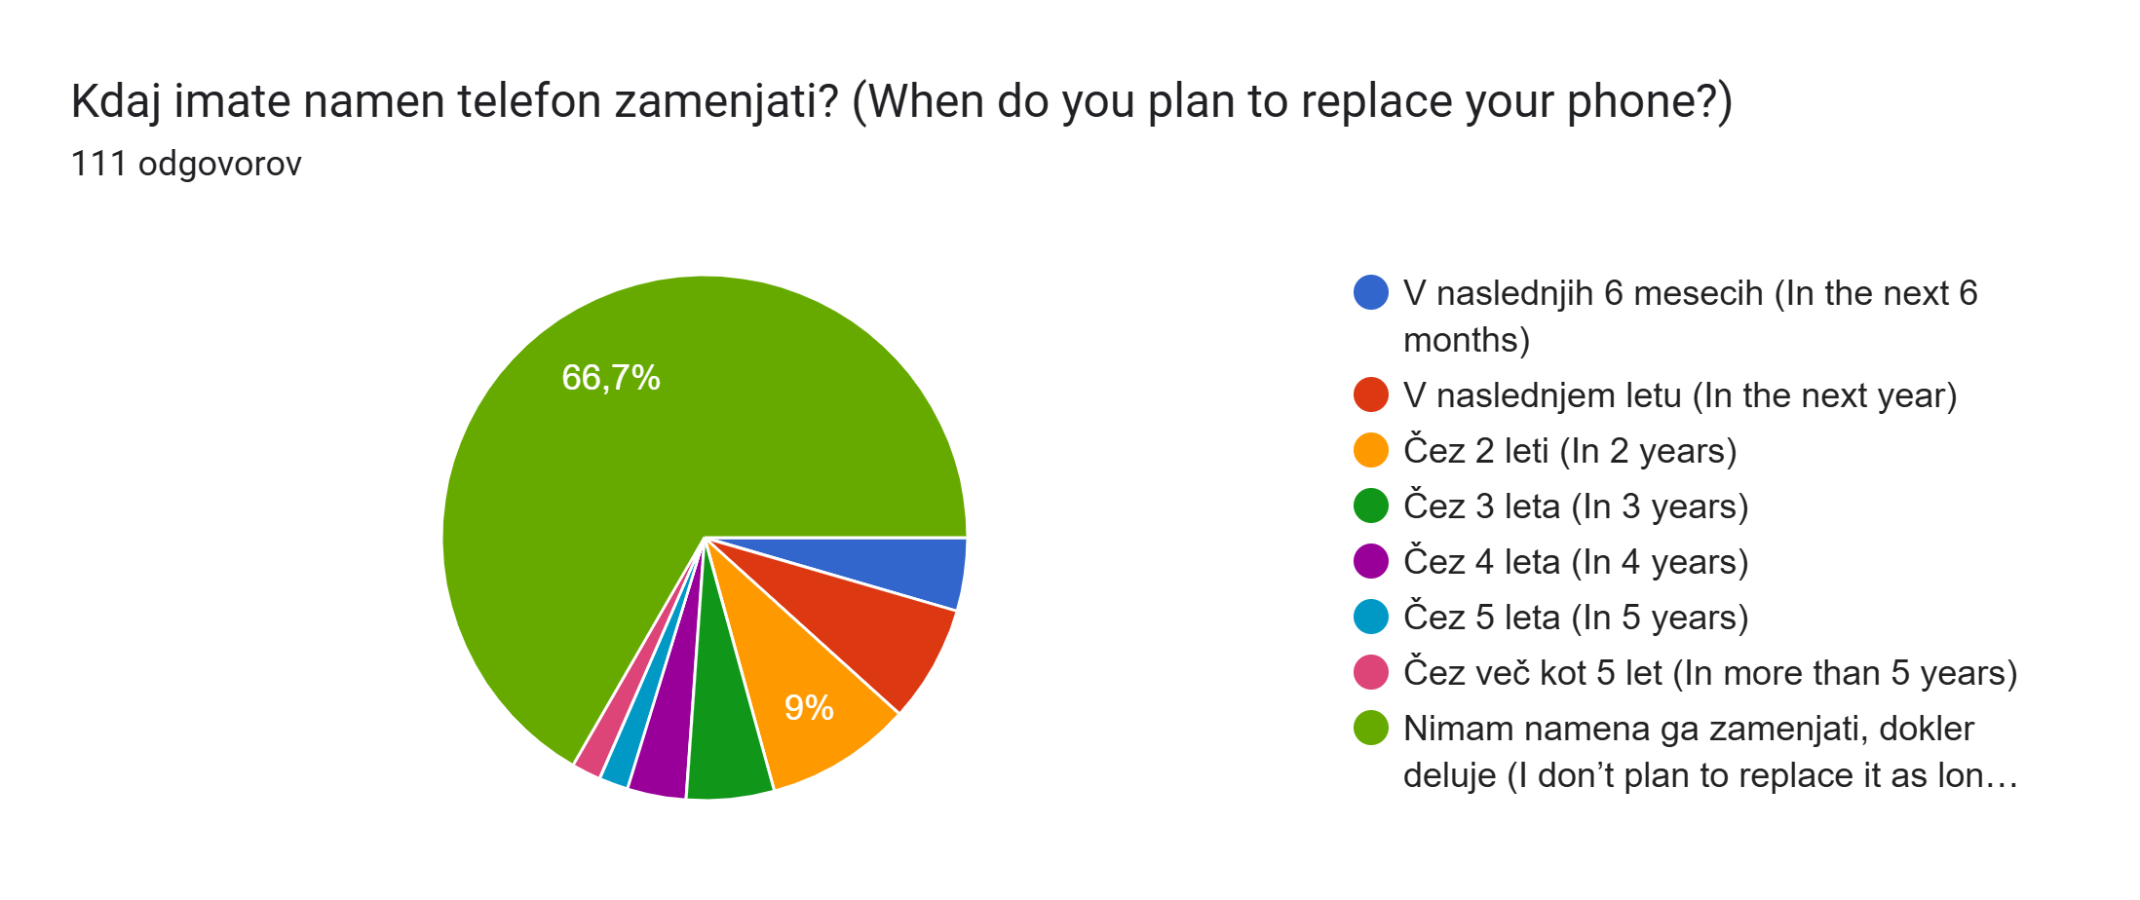
PROGRESS AND NEXT STEPS
RESULTS OF THE SURVEY (111 PARTICIPANTS, STUDENTS OF MULTIPLE TECHNICAL FACULTIES):
  SAMSUNG HAS THE MAJORITY
  MOST PARTICIPANTS KEEP THEIR PHONES AFTER THEY REPLACE THEM
  MOST PARTICIPANTS ARE WAITING FOR THEIR PHONES TO BREAKDOWN BEFORE THEY BUY A NEW ONE
TO BE DETERMINED: ARE THE STUDENTS ACTUALLY E-WASTE CONSCIOUS? HOW MUCH DO STUDENTS KNOW ABOUT BUY-BACK PROGRAMS AND E-WASTE MANAGEMENT?

